Slide 1

1. 跑步呼吸基础
2. 跑步呼吸方法之奇数呼吸法
3. 跑步呼吸方法之太极呼吸法
4. 用鼻子来呼吸, Why?
5. 模拟高海拔和高强度训练
6. Box Breathing
7. 其它的呼吸训练
8. 呼吸训练的极限

Slide 2
Disclaimer
Please don’t do anything stupid and get hurt. It would make us both quite unhappy. Consult a doctor, lawyer, and common-sense specialist before doing anything in this presentation.

Slide 3


Do we really need a training for breathing?

Slide 4

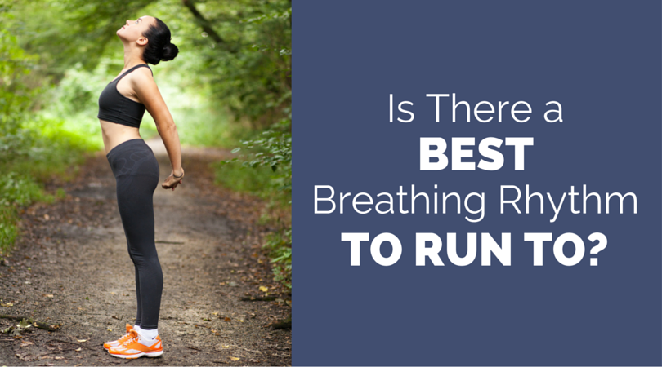
跑步呼吸基础
控制呼吸频率
呼吸频率在2-4分钟后稳定；呼吸深度在3-5分钟后稳定。
呼吸配合步伐
2-4步一吸气，2-4步一呼气的方法练习。
腹式呼吸 vs 胸式呼吸
2-4步一吸气，2-4步一呼气的方法练习。
速度慢时尽量用鼻子来呼吸

Slide 5

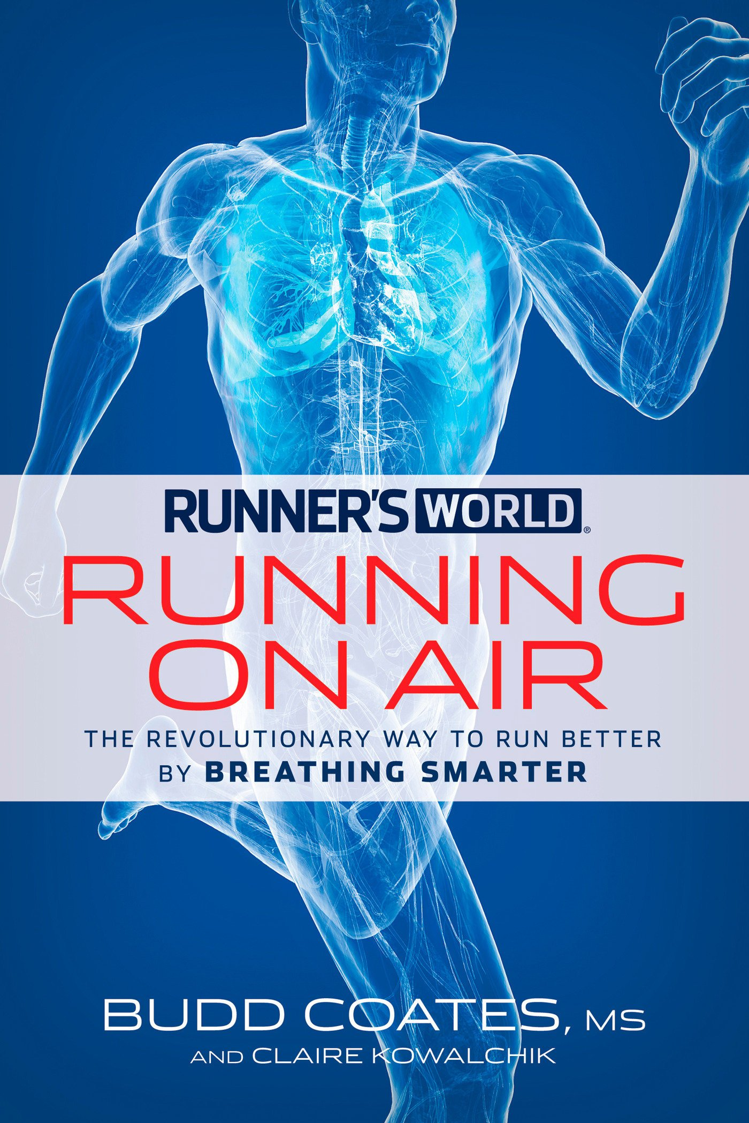
跑步呼吸方法之奇数呼吸法

Slide 6
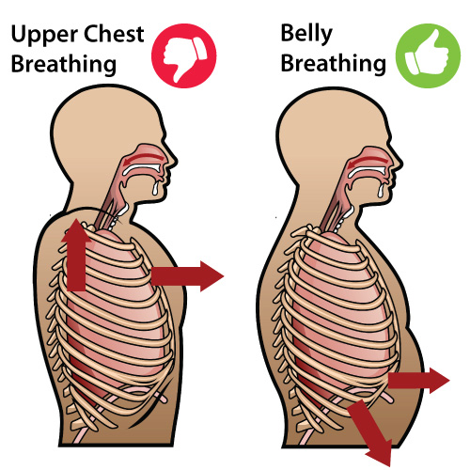

跑步呼吸方法之太极呼吸法
Belly breathe (diaphragmatic breathing) – inhale through nose, exhale through mouth by pulling your belly in
Match breath rate to cadence: exhale for two steps, inhale for one
Nose-breathe if possible

Slide 7
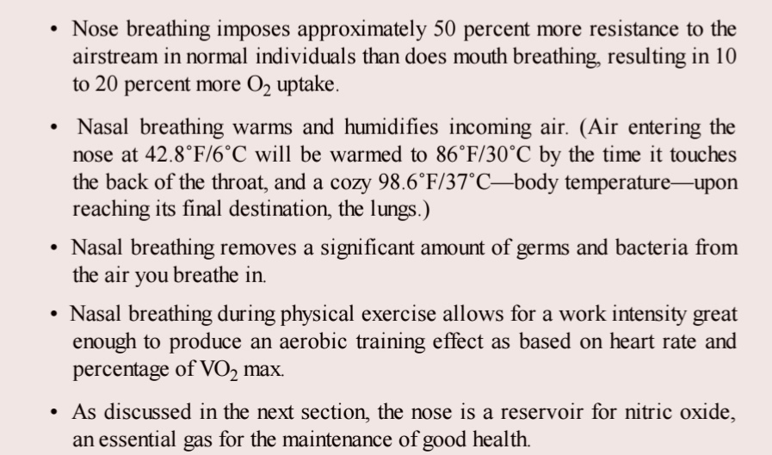

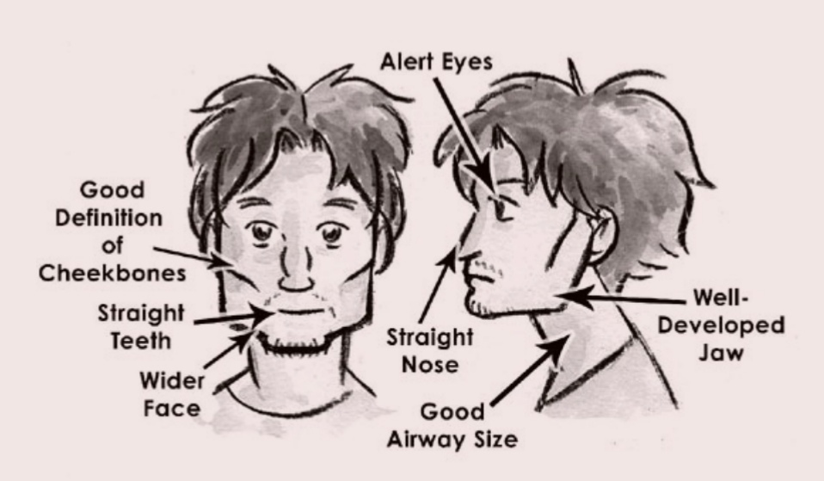
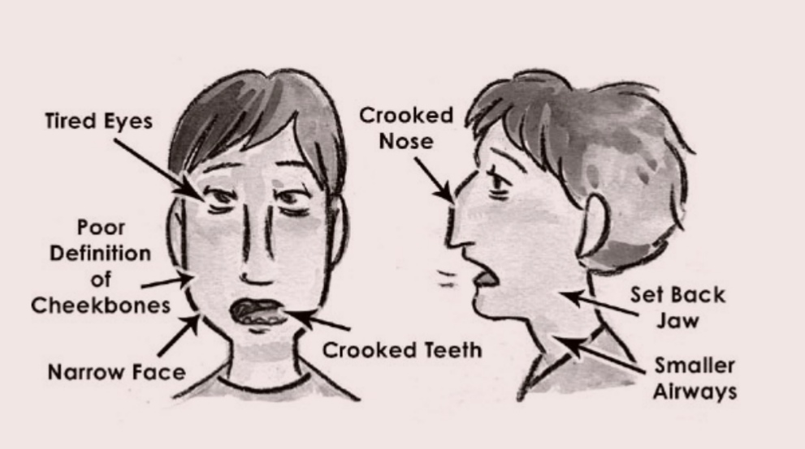
用鼻子来呼吸, Why?

Slide 8
用呼吸练习来模拟高海拔和高强度训练
The release red blood cells from the spleen, improving aerobic performance
A high tolerance to carbon dioxide
Reduced stress and fatigue of working muscles
Improved psychological preparedness
Improved recovery time
Reduced lactic acid
The ability to maintain fitness during rest of injury
Maintenance of these benefits without the need to ravel to high altitudes

Slide 9
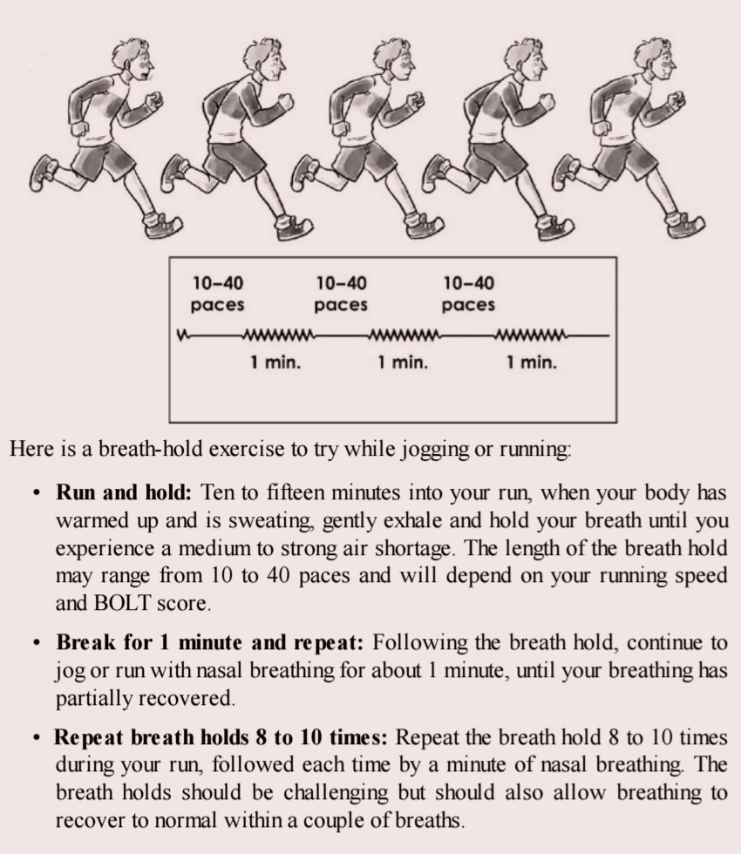
用呼吸练习来模拟高海拔和高强度训练

Slide 10

其它的呼吸训练 - Box Breathing
Step 1: Find a comfortable chair or place to lie down.
Step 2: Inhale for 4 seconds (while the circle above is expanding).
Step 3: Hold air in your lungs for 4 seconds (while the circle is expanded).
Step 4: Exhale for 4 seconds, emptying all of the air in your lungs (as the circle contracts).
Step 5: Hold your lungs empty for 4 seconds (while the circle is contracted).
Step 6: Repeat for five minutes, or as long as is necessary to feel refocused and relaxed.

Slide 11
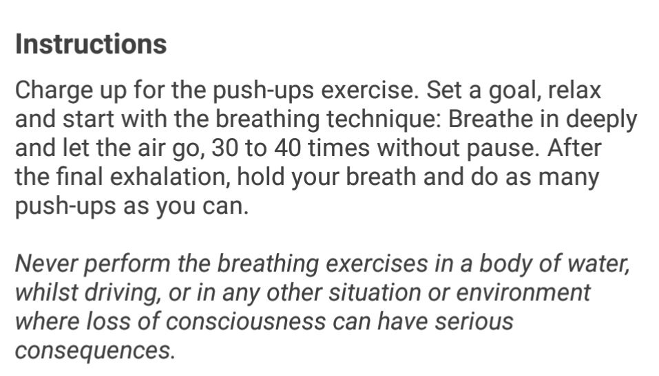

其它的呼吸训练 - Wim Hof method

Slide 12
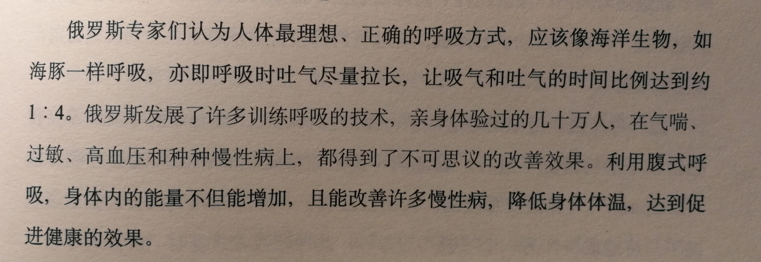

其它的呼吸训练 - Meditation

Slide 13


呼吸训练的极限
4 Stages:
Awareness Phase – urge to breath
Diaphragm Involuntary contractions – ignore if you are willing to suffer
Fresh blood from the spleen – psychological boost
Black out !
World record of breath holding: 11:54

Slide 14

Bonus

